Slide 1
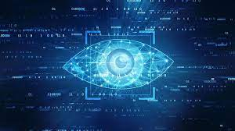

INT345 Computer Vision
Lecture #0
Agenda, Roadmap & Expectations

Slide 2

Course details
LTP – 2 0 2
Credits – 3.0
Mode – BYOD
Text Book
COMPUTER VISION: A MODERN APPROACH by DAVID A. FORSYTH, Pearson Education India
PROGRAMMING COMPUTER VISION WITH PYTHON: TOOLS AND ALGORITHMS FOR ANALYSING IMAGES by JAN ERIK SOLEM, O'REILLY

Slide 3
Course Assessment Model
Marks break up*
Attendance 5
CA 25
Project
1 Best out of 2 Test-code based
MTE 20
ETE 50
Total 100

Slide 4
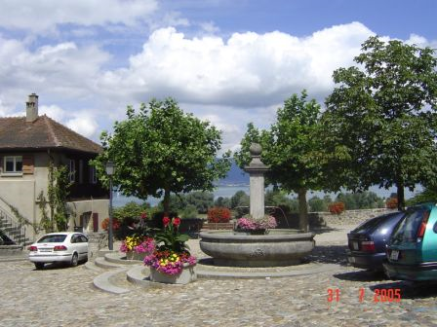
Computer Vision
Make computers understand images and video.
What kind of scene?
Where are the cars?
How far is the building?

Slide 5
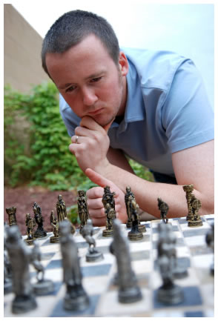
Vision is really hard
Vision is an amazing feat of natural intelligence
Visual cortex occupies about 50% of Macaque brain
More human brain devoted to vision than anything else
Is that a queen or a bishop?

Slide 6
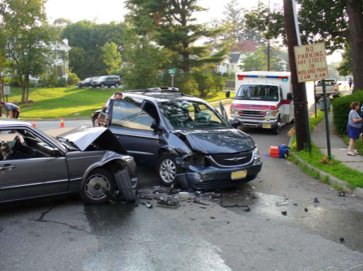
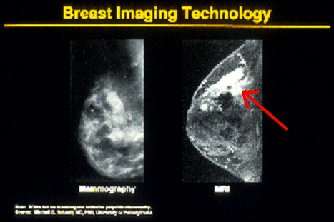
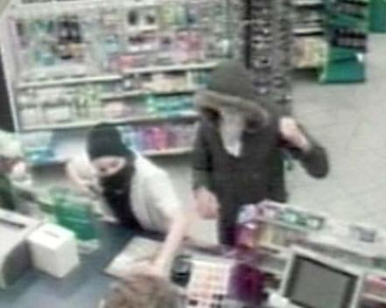

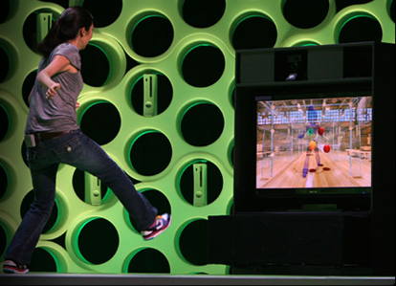
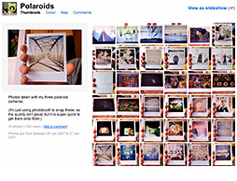
Why computer vision matters?
Safety
Health
Security
Comfort
Fun
Access

Slide 7
How vision is used now?
Examples of state-of-the-art

Slide 8
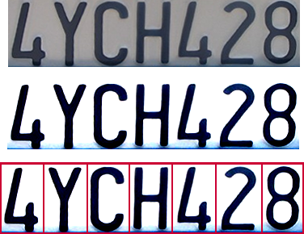

Optical character recognition (OCR)
Technology to convert scanned docs to text
If you have a scanner, it probably came with OCR software
Digit recognition, AT&T labs
http://www.research.att.com/~yann/
License plate readers
http://en.wikipedia.org/wiki/Automatic_number_plate_recognition

Slide 9
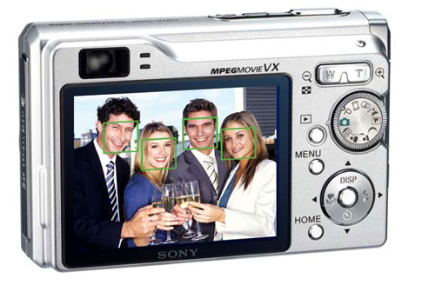
Face detection
Many new digital cameras now detect faces
Canon, Sony, Fuji, …

Slide 10
Smile detection
Sony Cyber-shot® T70 Digital Still Camera

Slide 11
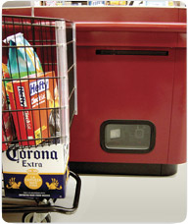
Object recognition (in supermarkets)
LaneHawk by EvolutionRobotics
“A smart camera is flush-mounted in the checkout lane, continuously watching for items. When an item is detected and recognized, the cashier verifies the quantity of items that were found under the basket, and continues to close the transaction. The item can remain under the basket, and with LaneHawk,you are assured to get paid for it… “

Slide 12
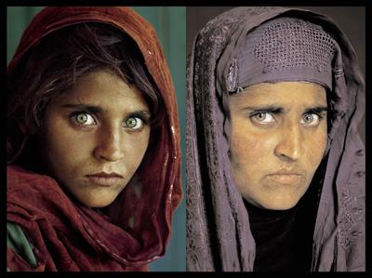
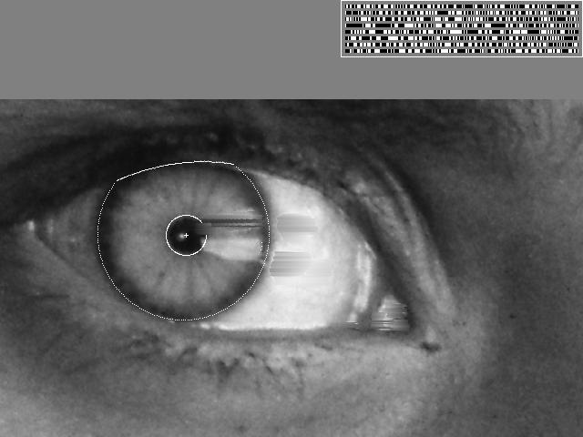
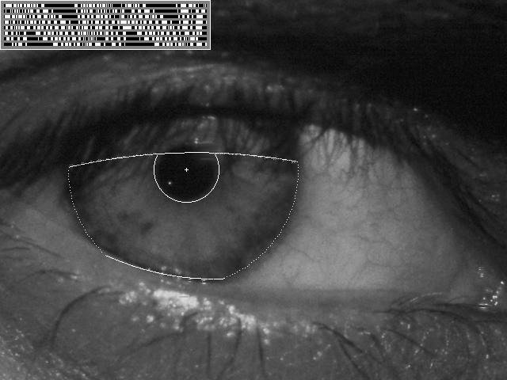
Vision-based biometrics
“How the Afghan Girl was Identified by Her Iris Patterns” Read the story
wikipedia

Slide 13
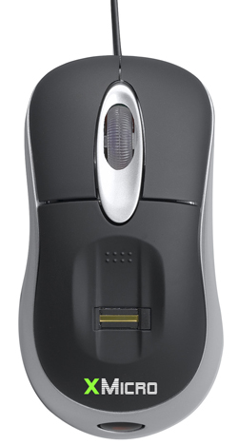
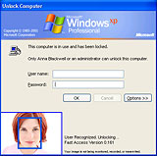
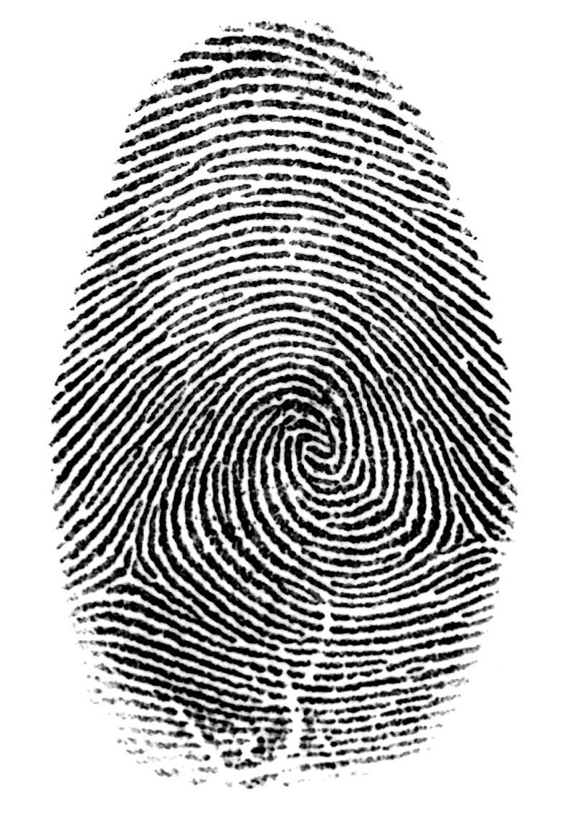

Login without a password…
Face recognition systems now beginning to appear more widely http://www.sensiblevision.com/
Fingerprint scanners on many new laptops, other devices

Slide 14
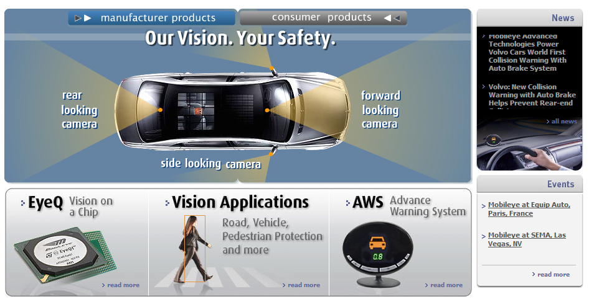
Smart cars
Mobileye
Vision systems currently in high-end BMW, GM, Volvo models
By 2010: 70% of car manufacturers.

Slide 15
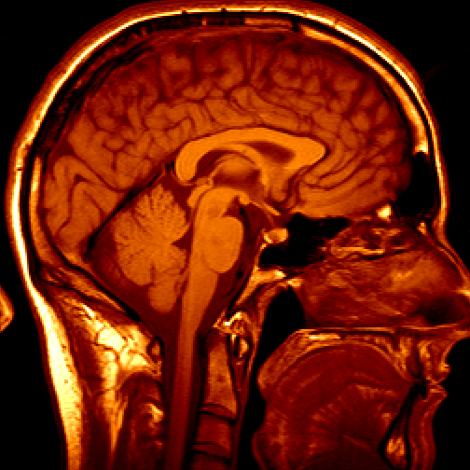
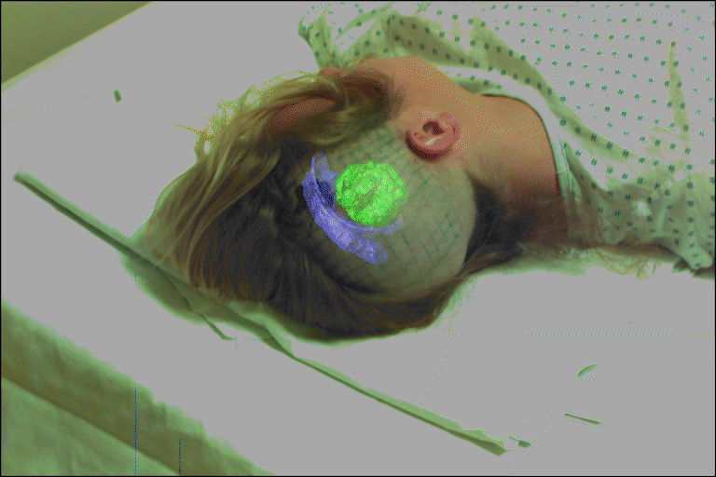
Medical imaging
3D imaging
MRI, CT
Image guided surgery
Grimson et al., MIT

Slide 16
The course contents: Unit 1
Fundamentals of Image Processing
Image acquisition and representation
Image file formats and color models
Overview of computer vision and its applications
Image Enhancement
Histogram equalization
Contrast enhancement
Thresholding
The EM algorithm
Frequency domain techniques
Image Filtering
Spatial filtering
Fourier transform
Geometric transformations

Slide 17
The course contents: Unit 2
2-D Projective Geometry
Planar geometry
The 2D projective plane
Projective transformations
Homography properties
Camera Geometry
Pinhole camera
Cameras with lenses
CCD cameras
General projective cameras
Affine cameras

Slide 18
The course contents: Unit 3
Stereo Geometry
Epipolar geometry
Fundamental matrix
Motion of camera
Normalized 8-point algorithm
Linear triangulation methods
Geometric error cost function

Slide 19
The course contents: Unit 4
Feature Detection and Description
Feature detection
Harris operator
Feature matching
Scale invariant feature transform
Speeded up robust features
Hessian operator
FAST
BRIEF
ORB
HOG
Texture descriptors
Image descriptors
Applications of descriptors
Feature Detection and Description
Weighted distance function
Similarity measures
EMD
Efficient computation of feature matching
K-D tree
LSH
Model fitting techniques

Slide 20
The course contents: Unit 5
Color Processing
The physics of color
Human color perception
Representing color
Model for image color
Surface color from image color
Range Image Processing
Active range sensors
Range data segmentation
Range image registration and model acquistion
Object recognition

Slide 21
The course contents: Unit 6
Clustering and Classification
Overview of classification
Probabilistic approach
Distance based
Discriminant analysis
ANN
Clustering techniques
Ilyod algorithm
K-Means algorithm
Dimensionality Reduction and Sparse Representation
PCA
LDA
Sparse representation
OMP algorithm
BP algorithm

Slide 22
The course outcome…
learn fundamentals of image processing, image enhancement and filtering.
familiar with various camera models such as pinhole camera model, camera calibration and lens distortion correction.
illustrate the concept of epipolar geometry including the epipolar constraint and fundamental matrix.
identify and extract relevant features from images using appropriate feature descriptors.
apply various processing techniques on color images and range images
apply various machine learning algorithms for image classification and clustering.

Slide 23
MOOC
https://onlinecourses.nptel.ac.in/noc23_cs77/preview
Computer Vision
by Prof. Jayanta Mukhopadhyay ,
IIT Kharagpur

Slide 24


